Slide 1
Meeting Week 16
Last week summary
Parameter recovery
Multisine design
Outline ToDo next week

Slide 2
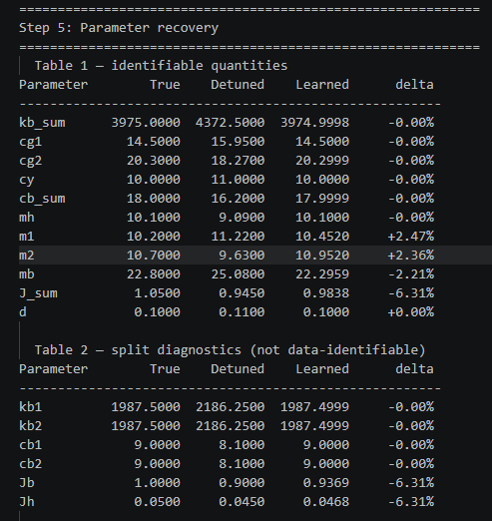
Last week summary
Periodic Schroeder multisine
  Added 40% of max hardware limit → needed to reduce this
Parameter recovery
  4 parameters where not currently identifiable

Slide 3
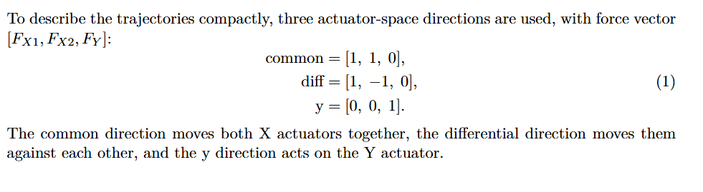
Trajectories
The different modes concept is taken from Garciá

Slide 4
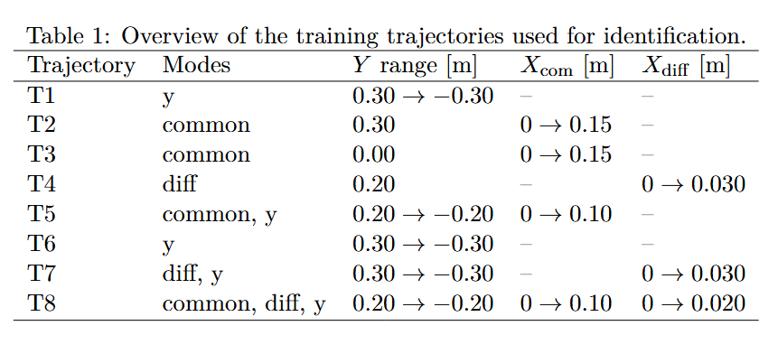
Trajectories
Note: T8, X moves in the same direction, but also creates an offset

Slide 5
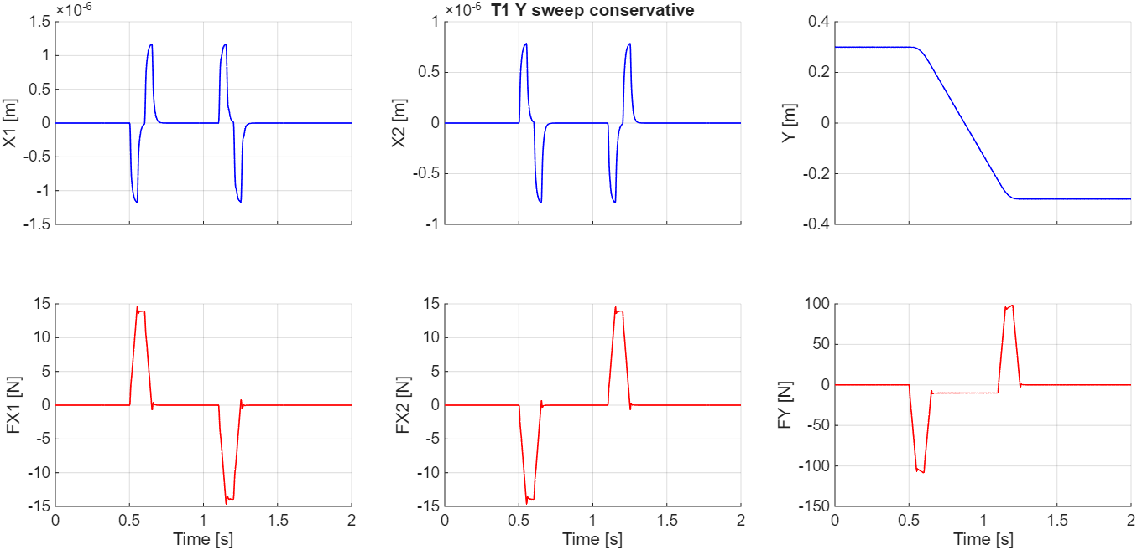
Notes:
u_q1 = Cfb * (r_sim - q1)

Slide 6
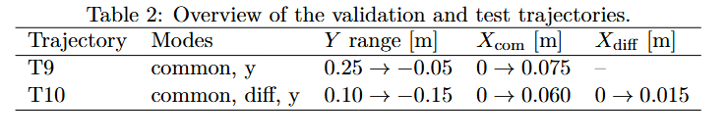
Trajectories

Slide 7
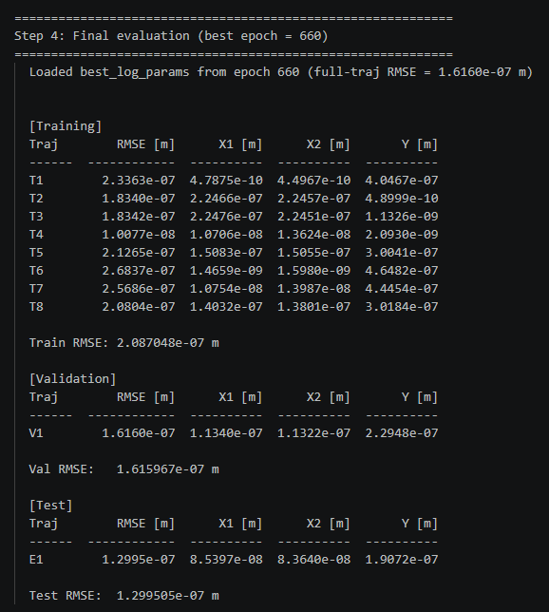
Trajectory – parameter recovery
Out of 1500 epochs, best validation RMSE for epoch 660

Slide 8
Trajectory – parameter recovery
Mainly J_sum
m1, m2 and mb

Slide 9
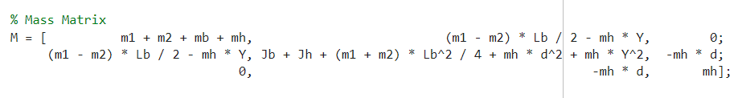
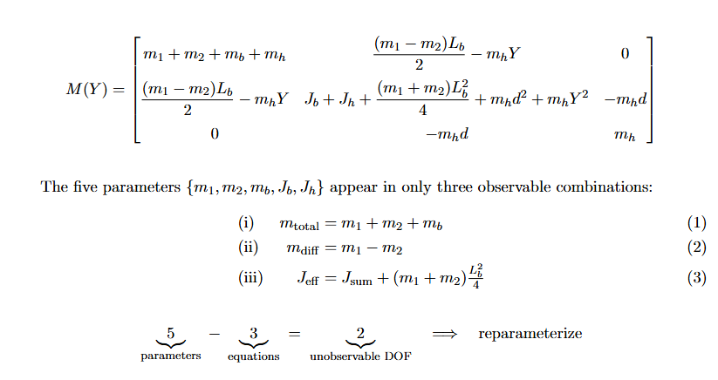

Trajectory – parameter recovery
If we sum the matrix indexes they match the true parameters exactly
But current problem: the individual parameters cannot be identified

Slide 11
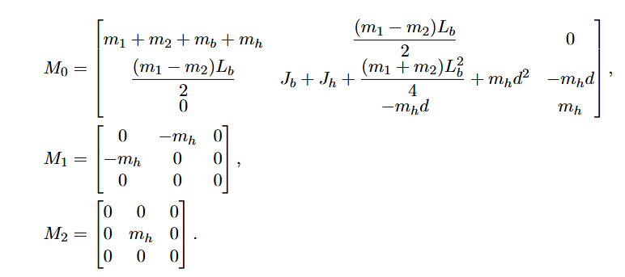
Print additional table for each matrix index

Slide 12
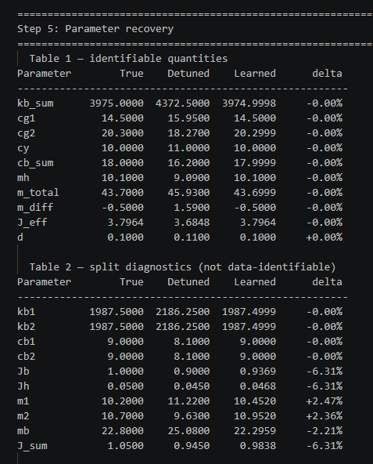
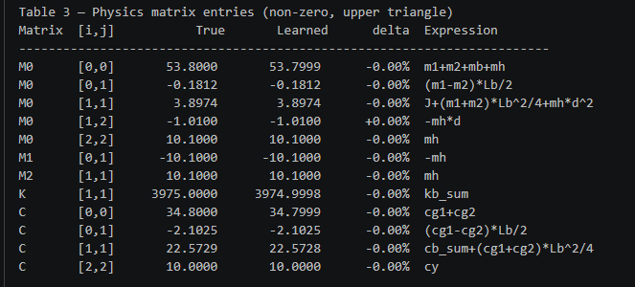

Slide 13
Yes — that's the real question and it's worth being precise.
Currently all 14 parameters are trainable, and gradients flow through all of them
into the matrix entries. The split_loss for Jb/Jh provides a weak restoring
force along n3, but both Jb and Jh still participate in the gradient through
M0[1,1] via J_sum = Jb+Jh.
What the reparameterization suggestion actually means for training is: instead of
training {m1, m2, mb, Jb, Jh} and building M0 entries from them, you directly
train {m_total, m_diff, J_eff} and write M0 entries as:
M0[0,0] = m_total + mh
M0[0,1] = m_diff · Lb/2
M0[1,1] = J_eff + mh·d²
The gradient then flows into m_total, m_diff, J_eff directly — no flat
directions, no split_loss needed for these.
The alternative — which is what you're implicitly asking — is: keep training all
14 (or the current structure with sums), and accept that what the gradient
actually updates is the identifiable combinations, with the individual splits
being pinned by split_loss.
Both are valid. The difference is:
- Reparameterize: cleaner, no redundant parameters, no need for split_loss on
these
- Keep current structure: more parameters than the data can determine, but
split_loss compensates for n1-n3, and you'd need to add something for n4
Given that n4 is currently unhandled and causing the mb/J_sum drift you observed,
the reparameterization is the cleaner fix. The split_loss for kb and cb can stay
as-is since those have physical motivation.
Currently still only reconstruction
  Parameters it sees sums and split loss for those
    Take older slide
Current model is able to identify properly but see problem left should I show the parameters as sums also??
m_total, m_diff, J_eff

Slide 14
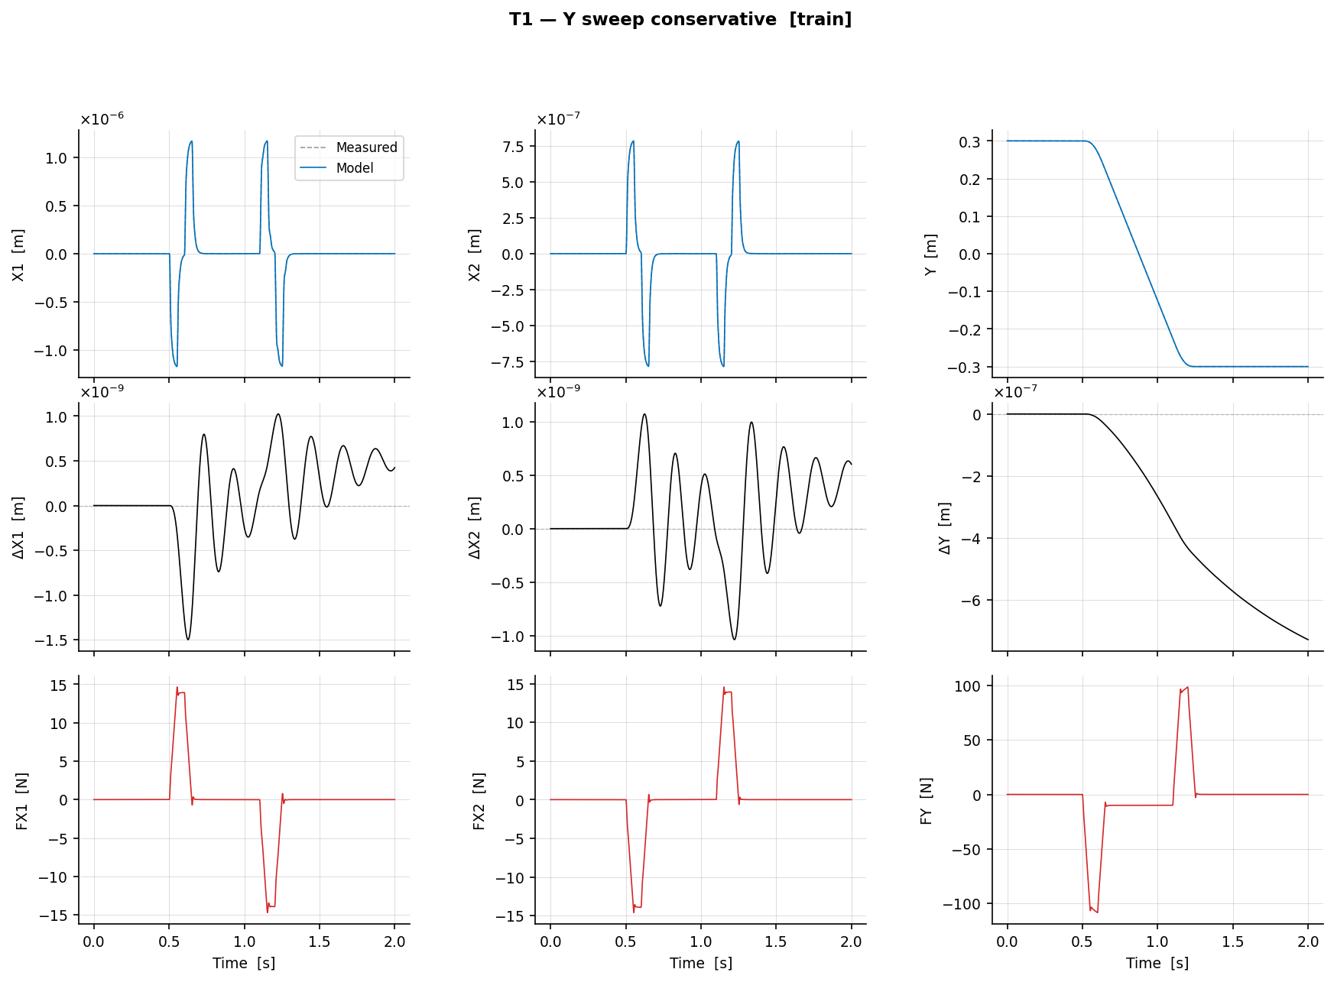
T1 – Y sweep conservative (training set)

Slide 15
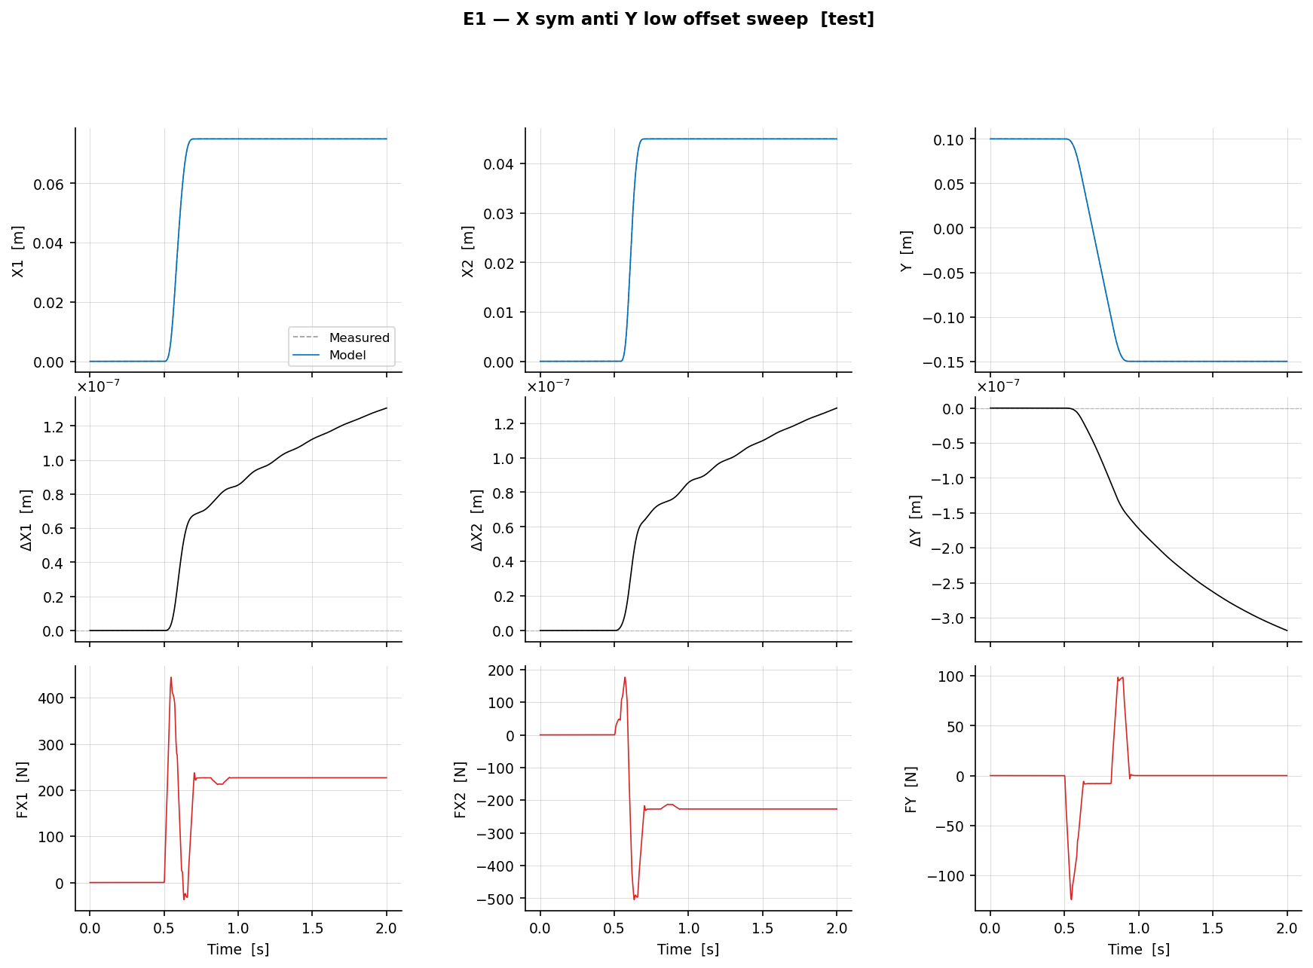
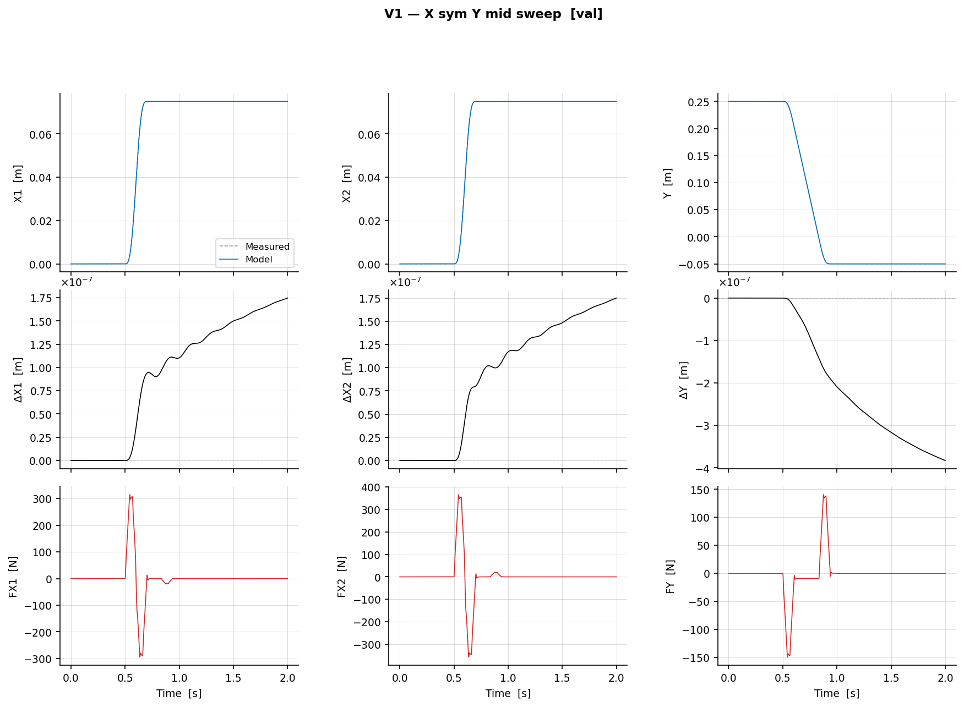
- Validation
- Test
Test
Validation

Slide 16
Trajectories + multisine
Why still apply multisine?
Why multisine on top of trajectories?
  Trajectory: covers the relevant operating range and LPV scheduling conditions
  Multisine: adds broadband excitation to reveal unmodeled residual dynamics
  Combined: learns the augmentation under realistic motion while still exciting hidden dynamics

Slide 17
Multisine
Took conservative range for now 1-100 hz
Multisine
  Looped over multiple rms percentages
  Looked at RMS difference position trajectories only minus position trajectories + multisine
  Chose the lowest percentage that satisfied this difference 1e-5 m
    Took an arbitrary number
- q_ms — position trajectory [X1, X2, Y] (N×3) from the simulation with multisine injected
- q_nom — position trajectory [X1, X2, Y] (N×3) from the trajectory-only simulation (no multisine)
- q_ms - q_nom — the pure position perturbation caused by the multisine (N×3)
- md.f_vec — the modal direction vector, e.g. [1, 1, 0] for common mode. Used here as a projection: (q_ms -
q_nom) * [1,1,0]' gives a scalar signal = X1_diff + X2_diff, projecting the 3-axis perturbation onto the
active mode direction
- rms(...) — RMS of that scalar perturbation signal over time
- B_sweep(i, r_idx) — the result: how much the multisine moves the system in the active modal direction, for
trajectory i at rho candidate r_idx
Notes:
Took a conservative multisine frequency band of 1-100 Hz for now.
Generated Schroeder-phase odd-harmonic multisine force signals.
Swept multiple relative RMS force levels rho = [1%, 2%, 5%, 10%].
For each single-mode trajectory, compared the simulated position response without multisine against the response with multisine.
Computed the modal RMS displacement difference:
B = rms((q_ms - q_nom) * f_vec')
Chose the lowest rho per mode for which this difference exceeded 1e-5 m, while also satisfying actuator force limits.
The 1e-5 m threshold was chosen as a practical/arbitrary detectability floor, corresponding to about 10 micrometers.

Slide 18
Multisine
Took conservative range for now 1-100 hz
Multisine
  Looped over multiple rms percentages
  Looked at RMS difference position trajectories only minus position trajectories + multisine
  Chose the lowest percentage that satisfied this difference 1e-5 m
    Took an arbitrary number
B(rho) = rms(q_ms - q_nom, projected onto mode) minimum rho that satisfies this (heuristic)
  B_min = 1e-5 m
    Determined based on trajectories that only excite one mode
- q_ms — position trajectory [X1, X2, Y] (N×3) from the simulation with multisine injected
- q_nom — position trajectory [X1, X2, Y] (N×3) from the trajectory-only simulation (no multisine)
- q_ms - q_nom — the pure position perturbation caused by the multisine (N×3)
- md.f_vec — the modal direction vector, e.g. [1, 1, 0] for common mode. Used here as a projection: (q_ms -
q_nom) * [1,1,0]' gives a scalar signal = X1_diff + X2_diff, projecting the 3-axis perturbation onto the
active mode direction
- rms(...) — RMS of that scalar perturbation signal over time
- B_sweep(i, r_idx) — the result: how much the multisine moves the system in the active modal direction, for
trajectory i at rho candidate r_idx

Slide 19
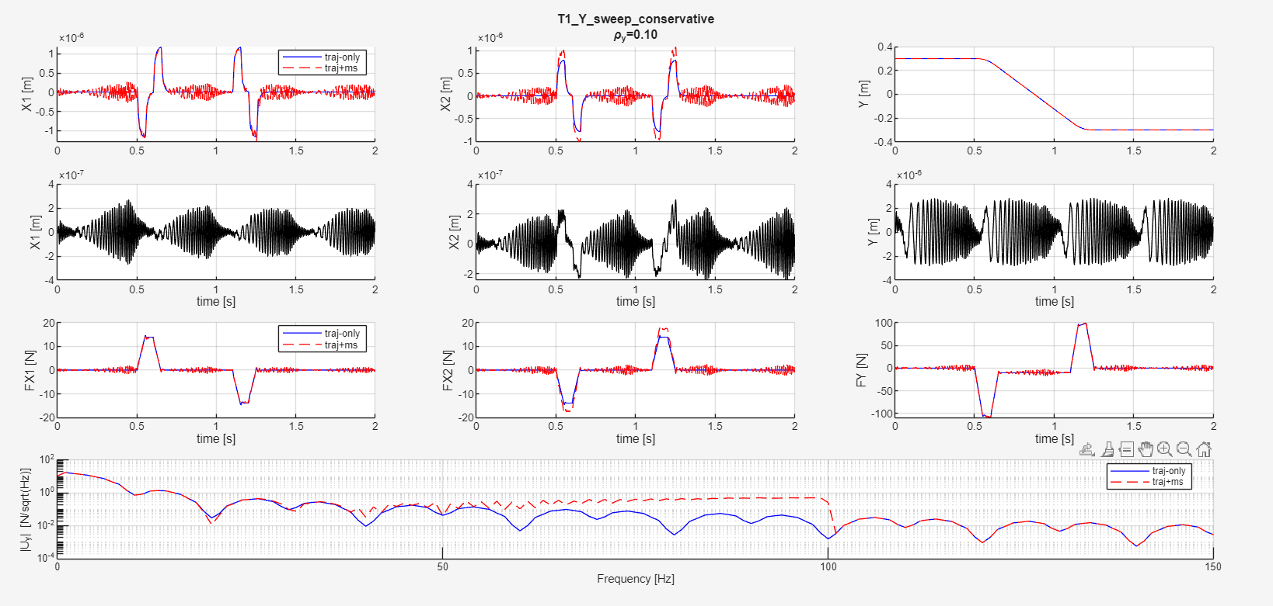
Plots multisine
Notes:
Mismatch m1 m2
Controller for the difference
Multisine only on Y here, because for that mode we are looking
Row 1 - Position overlay
The commanded trajectory position vs the actual simulated position, with and without multisine.
Row 2 - Position perturbation
The difference q_ms - q_nom. Isolates exactly what the multisine adds to the position. For inactive channels
Row 3 – Additional Force
Input force to the plant
Row 4 - Force spectrum
The frequency content of the actuator force in the active modal channel, before and after multisine injection.

Slide 20
Plots multisine
Row 1 - Position overlay
The commanded trajectory position vs the actual simulated position, with and without multisine.
Row 2 - Position perturbation
The difference q_ms - q_nom. Isolates exactly what the multisine adds to the position. For inactive channels
Row 3 – Additional Force
Input force to the plant
Row 4 - Force spectrum
The frequency content of the actuator force in the active modal channel, before and after multisine injection.
Notes:
Took conservative range for now 1-100 hz

Slide 21
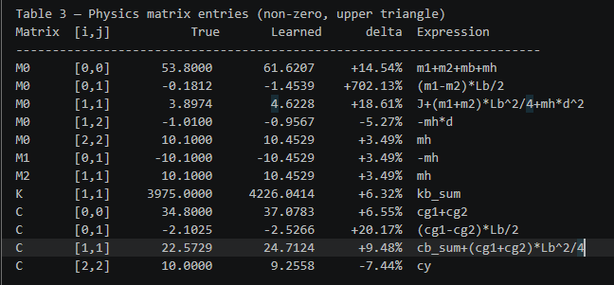
Parameter recovery
Multisine

Slide 22
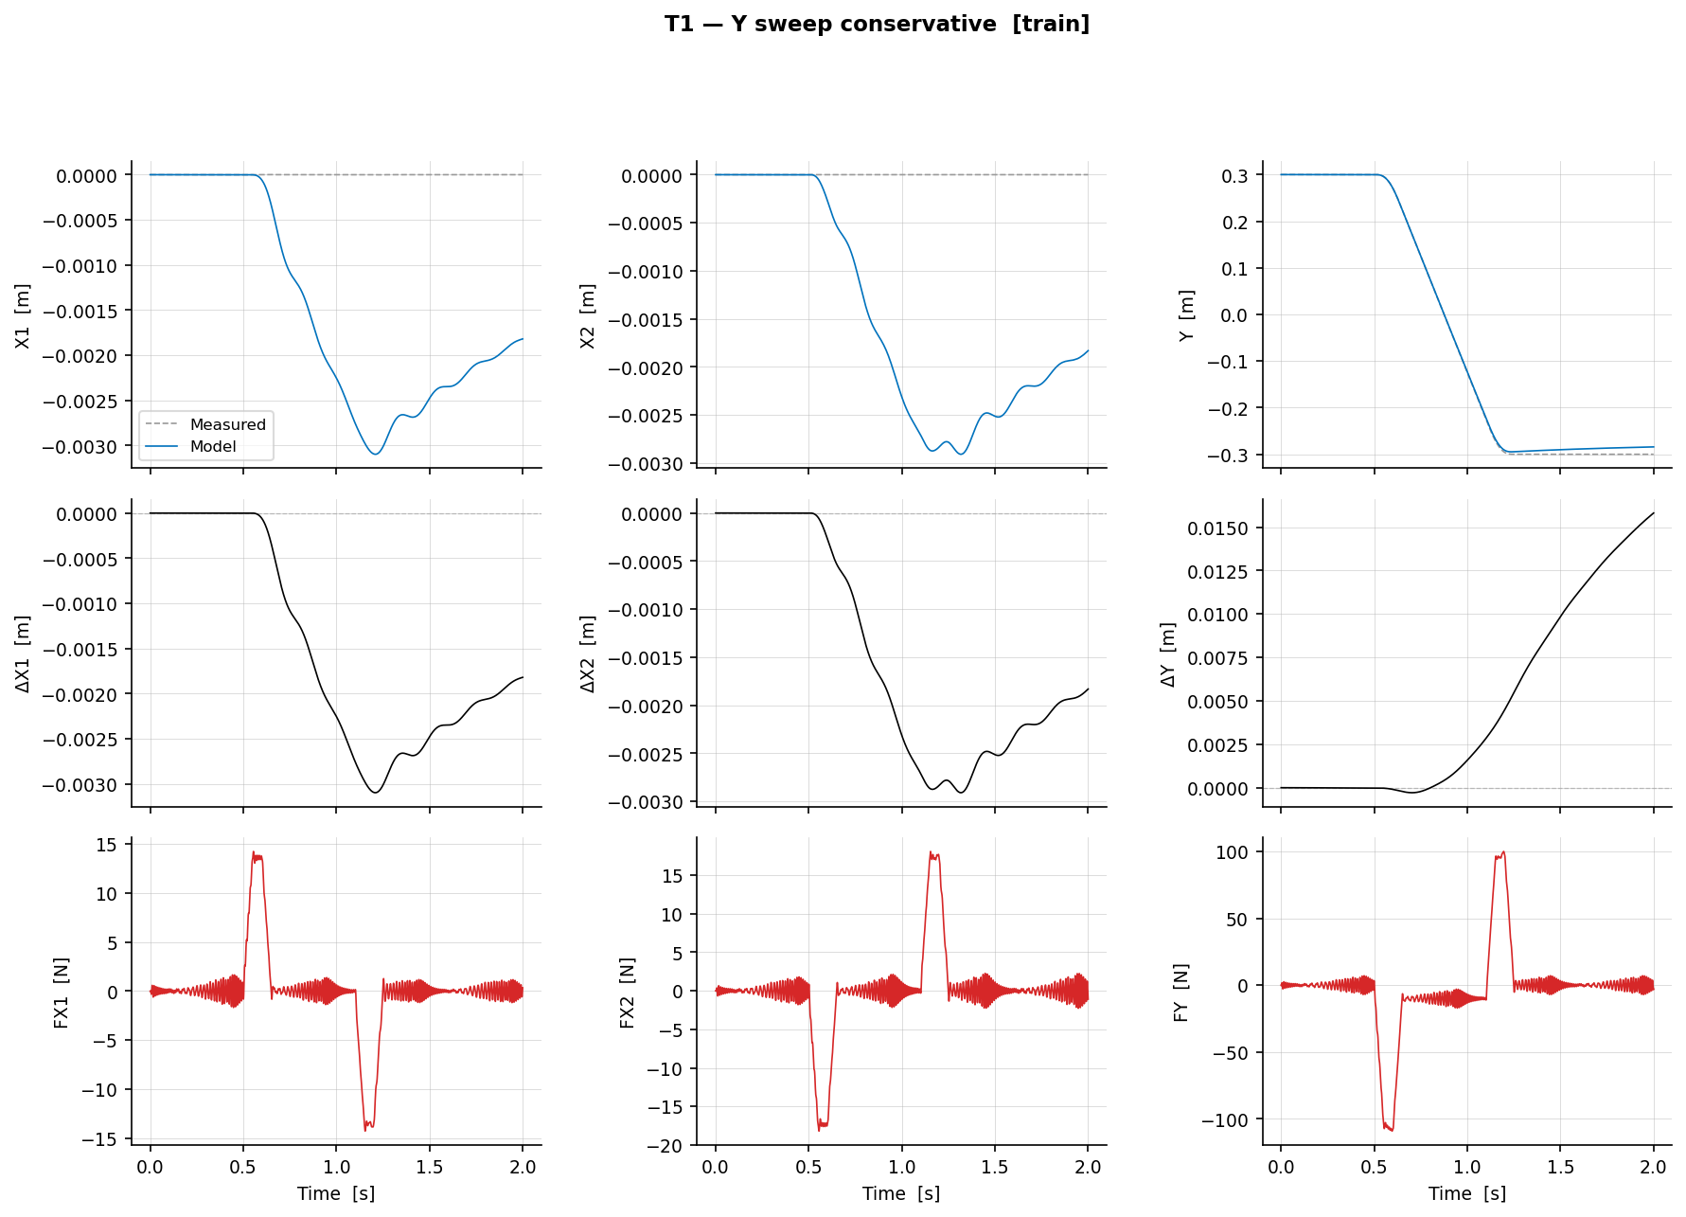
T1 – Y sweep conservative (training set)

Slide 23
T1 – Y sweep conservative (training set)

Slide 24
Frequency range multisine
Previously frequency range chosen by:
  which injected-force frequencies survive the closed-loop feedback
  which surviving frequencies produce measurable plant motion
Instead need to design for the system:
  FRF
    Need to consider multiple Y-positions
    Do multiple tests for different modes

Slide 25
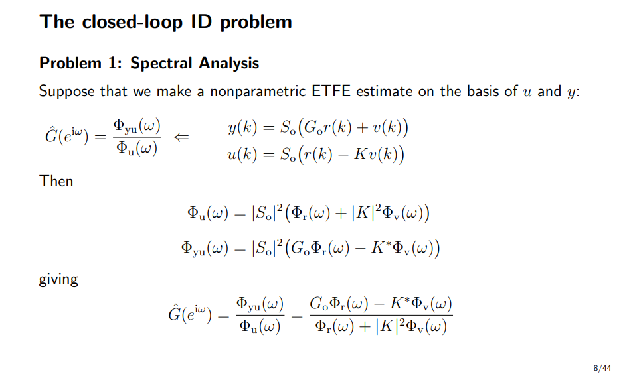

Slide 26
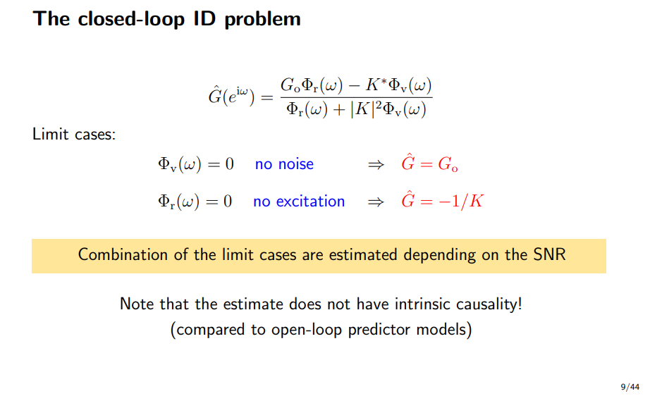

Slide 27
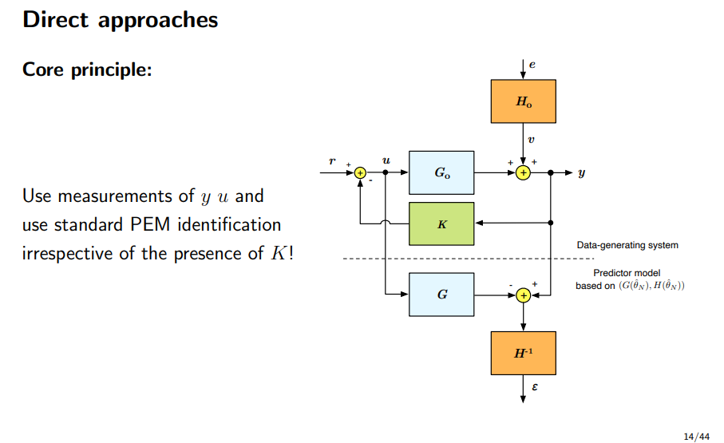
Direct approach
Not correct direct approach figure

Slide 28
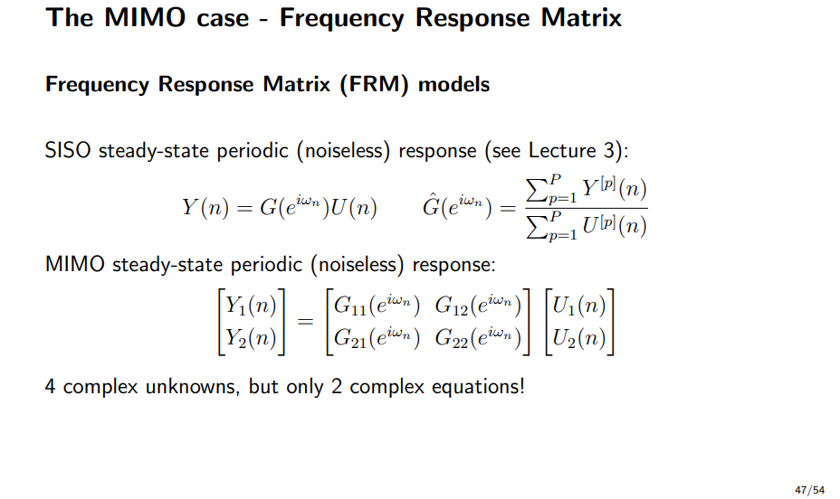

Slide 29
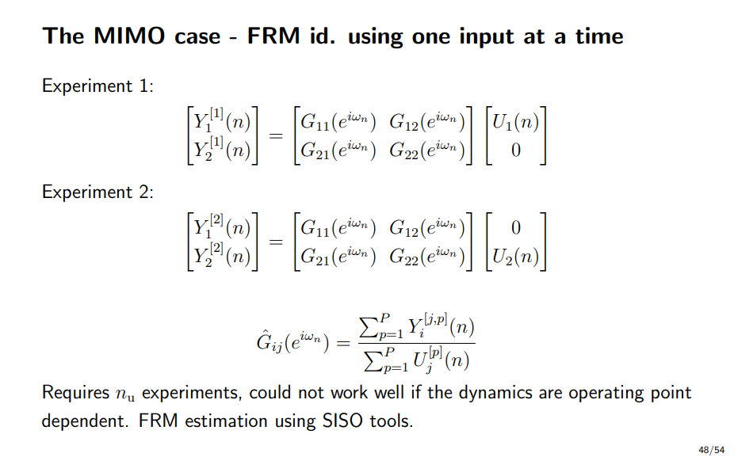
Operating point dependent: treat as LTI Y positions
Coupling is present so I cannot only excite one channel…

Slide 30
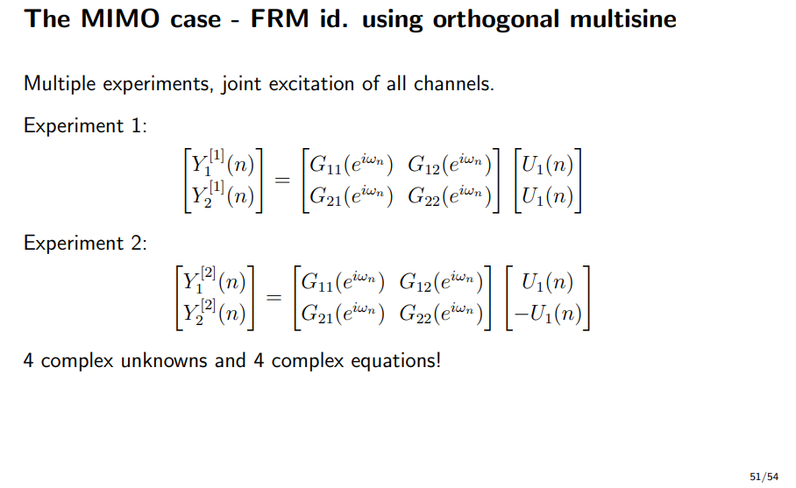

Slide 31
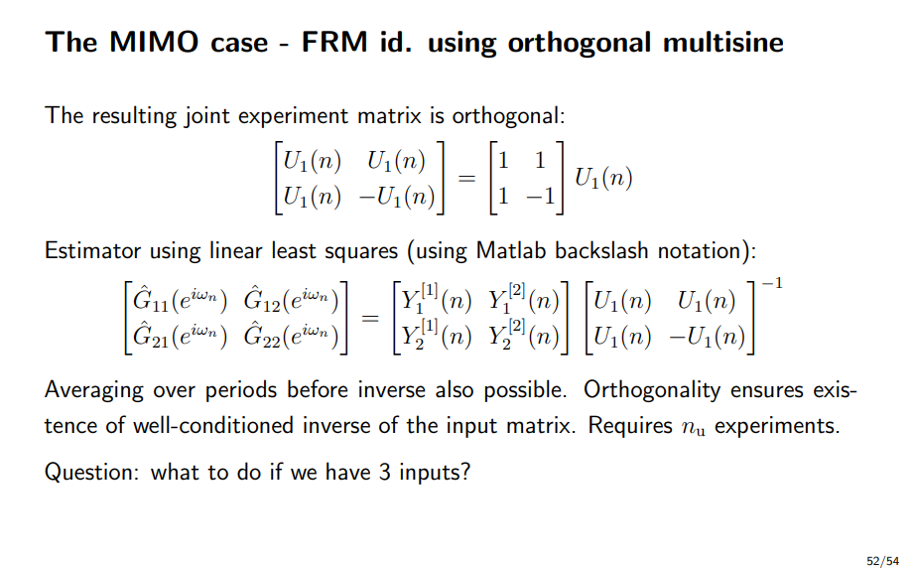

Slide 32
Outline next week
Multisine design
  What is causing the issue for identifiability
  Feedback Maarten not Schroeder but random multisines generate choose with low crest factor
Resampling
  → Determine highest frequency in the system
Plan meeting next week

Slide 33
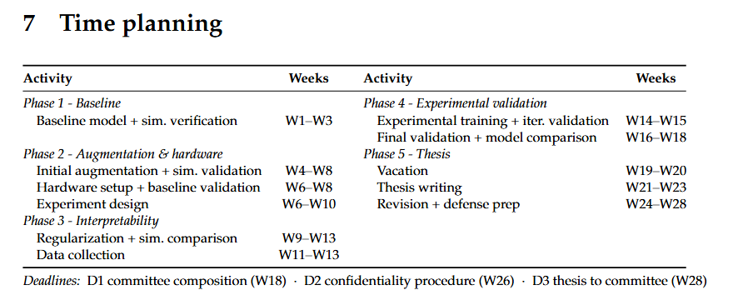
Planning – Week 8

Slide 34
Planning – Week 8

